Slide 1
Lipoproteins Very low-density, Low-density, Intermediate-density, High-density, & Chylomicrons
Lipoprotein Function & Exercise
March 16, 2009
Author: Mr. Christe A. Marbbn

Slide 2
Table of Contents
Unesterified
Cholesterol
Part I. An Overview of Lipoproteins
What are Lipoproteins
Lipoprotein Composition
Classifications
Lipoprotein
Synthesis
Metabolism
Exogenous Pathway
Endogenous Pathway
Lipoproteins and its Link to Disease
Protein
Phospholipid
Cholesterol Ester &
Triglycerides
Figure 1. Schematic diagram of a Lipoprotein.

Slide 3
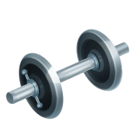
Table of Contents Continued
Part II. Current Research on Lipoproteins
The Effect of Physical Exercise on Plasma Lipoproteins.
Part III. References
Cholesterol Protein
Lipoproteins vary in
size and composition
HDL LDL

Slide 4
Part I: An Overview of Lipoproteins
What are Lipoproteins
Lipoproteins are roughly spherical particles with a lipid core composed mainly of triglycerides and cholesterol ester and a surface layer containing phospholipid, cholesterol, and protein [11].
When lipids (cholesterol, triglycerides) are absorbed by the intestines after a meal, they travel in the bloodstream as constituents of lipoproteins due to their poor solubility in the bloodstream; their hydrophilic components are made soluble by attachment to proteins and phospholipids.
Lipoproteins travel through the blood, delivering attached lipids to all the parts of the body.

Slide 5
Part I: An Overview of Lipoproteins
Lipoprotein Composition
Lipoproteins are composed of an outer water-soluble surface and an inner water-insoluble core. The outer portion comprises of phospholipids, protein, and cholesterol, with triglycerides and cholesterol ester forming the core.
The specific proteins associated with lipoproteins are called apolipoproteins (five major classes, A-E). The surface proteins enable the lipoproteins to interact with other membranes such as those lining blood vessels [11].
Apolipoproteins also serve as enzyme co-factors, receptor ligands, and lipid transfer carriers that regulate the metabolism of lipoproteins and their uptake in tissues [11].

Slide 6
Comparison of Cholesterol versus Cholesterol Ester
Cholesterol
Cholesterol Ester
Cholesterol contains a hydroxyl group (alcohol), whereas a cholesterol ester has an ester group.
This means that the cholesterol ester is much more hydrophobic than cholesterol.

Slide 7
Part I: An Overview of Lipoproteins
Lipoprotein Classifications
Chylomicrons: Very large particles that carry dietary lipids; they are associated with a variety of apolipoproteins (A-C, E).
Very-Low Density Lipoprotein (VLDL): Low density particles that carry endogenous triglycerides and to a less extent cholesterol from the liver to other parts of the body.
Intermediate Density Lipoprotein (IDL): Carries cholesterol esters (the hydroxyl group of the cholesterol is esterified to an unsaturated fatty acid) and triglycerides.
Low Density Lipoprotein (LDL): Carries cholesterol esters from the liver to rest of the body and is associated with apolipoprotein B100. The “Bad” cholesterol.
High Density Lipoprotein (HDL): Carries cholesterol esters from organs back to the liver for degradation to bile acids. The “Good” cholesterol.
Density
Lipoproteins are usually classified by their densities.
The density increases as the protein content increases.
There are five major types, each of which has a different function.

Slide 8
Part I: An Overview of Lipoproteins
Table 1. Major Classes of Lipoproteins in Human Plasma [5].
Lipoprotein class | Density (g mL⁻¹) | Diameter (nm) | % Protein | % Cholesterol | % Phospholipid | % Triglycerides
HDL | 1.063–1.210 | 5–15 | 33 | 30 | 29 | 8
LDL | 1.019–1.063 | 18–28 | 25 | 50 | 21 | 4
IDL | 1.006–1.019 | 25–50 | 18 | 29 | 22 | 31
VLDL | 0.95–1.006 | 30–80 | 10 | 22 | 18 | 50
Chylomicrons | <0.95 | 100–1000 | <2 | 8 | 7 | 84
Lipoprotein Classifications Continued…

Slide 9
Part I: An Overview of Lipoproteins
Lipoprotein Synthesis
Lipoproteins arise from enterocytes in the intestine, forming chylomicrons, and hepatocytes in the liver, forming, VLDL, HDL, and IDL.
The assembly of chylomicrons within the enterocyte and the subsequent secretion of these lipoprotein particles into the lymph is a complex, multi-step process that includes [4]:
The absorption of lipids by the enterocytes;
Cellular lipid (re)synthesis and translocation of cellular lipid pools;
Synthesis and post-translational modification of various apolipoproteins;
The assembly of lipid and lipoprotein components into a chylomicron.
The key process in chylomicron synthesis is the intracellular association of apolipoprotein ApoB48, the structural protein of chylomicrons, with lipids [4].
Notes:
Chylomicron synthesis by intestinal cells in vitro and in vivo Atherosclerosis, Volume 141, Issue null, Pages S9-S16 M. M.J. van Greevenbroek, T. W.A. de Bruin

Slide 10
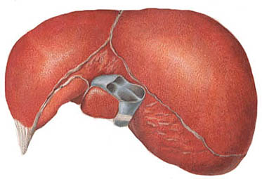
Part I: An Overview of Lipoproteins
Lipoprotein Metabolism
1
Small
Intestine
Lumen
Exogenous Pathway [10]
Lipids are
digested
LPL catalyzes a hydrolysis reaction, releasing glycerol and fatty acids from the chylomicrons. Glycerol and fatty acids can be absorbed by the tissue .
Enterocytes (Epithelial Cell)
2
Lipid assembled
with apolipoprotein
B-48 into nascent
chylomicrons
Liver
Lymphatic
Vessel
Mature chylomicron
activate lipoprotein
Lipase (LPL)
4
Thoracic Duct
Mature Chylomicron
formed
Blood Stream
3
HDL donates
Apolipoprotein C-II and E
ApoC can only bind to receptors found
on adipose tissue while ApoE can only
bind to receptors on hepatocytes.
Remnant
chylomicron
5
Remnants are endocytosed and hydrolyzed within lysosomes. This also releases glycerol and fatty acids in the cell.

Slide 11
Part I: An Overview of Lipoproteins
1
Triacylglycerol and
cholesterol are
assembled with
apolipoprotein
B-100 to form
VLDL
Lipoprotein Metabolism
Endogenous Pathway [10]
Liver
Apolipoprotein C-II activates LPL, causing hydrolysis of the VLDL particle and the release of glycerol and fatty acids. Glycerol and fatty acids can be absorbed by adipose tissue and muscle
3
Nascent VLDL
Thoracic Duct
Bloodstream
2
Mature VLDL
formed
HDL donates
Apolipoprotein C-II and E
The hydrolyzed VLDL
particles are now called IDL
4
IDLs return to the liver and are further hydrolyzed by hepatic lipase. This releases glycerol and fatty acids,
leaving behind IDL remnants, called LDL. After LDLs bind to target tissues, they are endocytosized. The
internalized LDL particles are hydrolyzed with lysosomes, releasing mainly cholesterol.

Slide 12
Part I: An Overview of Lipoproteins
The link between lipoproteins and Disease
Small, dense LDL has several characteristics that are linked to atherogenesis (plaque in the inner lining of arteries) [6]:
Long residence time in plasma
Enhanced oxidizability
Arterial proteoglycan binding
Permeability through the endothelial barrier

Slide 13
Part I: An Overview of Lipoproteins
The only protein associated with LDL is ApoB100; LDL’s do not possess ApoC or ApoE.
ApoC and ApoE are required for the lipoprotein to be taken up by the adipocytes and hepatocytes. ApoB100 can bind to the LDL receptors (LDLR) found on the liver; however, the affinity for the LDLR is very low.
This means the half-life of LDL in the blood is much longer than IDL and VLDL.
Cholesterol
ApoB100
LDL is the source of cholesterol in the body
When it is present in high amounts (levels in the blood are high), then LDL becomes a problem.

Slide 14
Part I: An Overview of Lipoproteins
As LDL travels through the blood-
stream, it gets oxidized by free
radicals (Cu²⁺ and Fe²⁺) [8].
Blood Vessel
Red Blood Cell
When it gets oxidized, it binds
to the endothelium of the
blood vessels via receptor CD36
[8].
Blood Vessel
Lumen
LDL then deposits the
cholesterol just beneath the
endothelium.
This eventually leads to
atherosclerosis
(hardening of the blood
vessels), as well as, the
formation of puss and
platelet aggregation, which causes narrowing of the lumen of the blood vessel, leading to problems such as heart diseases and stroke.
Fatty material deposits

Slide 15
Part II. Current Research on lipoproteins
The Effect of Exercise on Plasma Lipoproteins
Regular physical exercise is a deterrent of cardiovascular disease, and its anti-atherogenic effects have been described in human studies [1].
On the contrary, physical inactivity has adverse consequences on cardiovascular risk, due in part to detrimental effects of serum lipoprotein concentration, namely LDL [3].

Slide 16
Part II. Current Research on lipoproteins
To investigate the effects of the amount and intensity of exercise on risk factors for cardiovascular disease, Bales et al. (2002) devised an experiment where overweight and obese men and women with mild-to-moderate dyslipidemia (elevation of lipids in the blood) were randomly assigned to a nonexercising control group or one of three training groups [2]:
High-amount/high-intensity exercise, the caloric equivalent of 32 km of jogging per week;
Low-amount/high-intensity exercise, the caloric equivalent of 19.2 km of jogging per week;
Low-amount/moderate-intensity exercise, the caloric equivalent of 19.2 miles of walking per week.

Slide 17
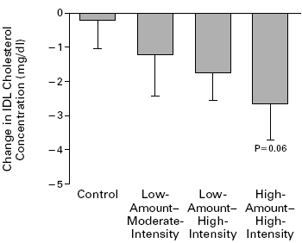
Part II. Current Research on lipoproteins
Upon completion of the study:
High-amount/high-intensity exercise significantly reduced the concentrations of LDL [2].
The IDL cholesterol concentration decreased with increasing exercise levels [2].
Figure 2.Comparison of the effects of three different exercise programs on LDL and IDL concentrations. Modified from [2].

Slide 18
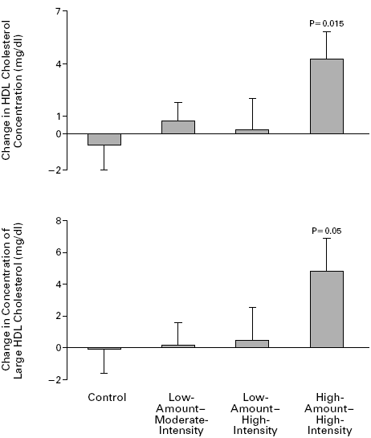
Part II. Current Research on lipoproteins
There was a clear beneficial effect on the HDL cholesterol concentration in the high-amount/high-intensity group. The lower amount of exercise had a smaller effect on these variables, with no apparent effect of the intensity of exercise [2].
The data shows a clear effect of the amount of exercise on lipoproteins; it also shows that a relatively high amount of regular exercise — even in the absence of clinically significant weight loss — can significantly improve the overall lipoprotein profile [2].
Figure 3.Comparison of the effects of three different exercise programs on HDL concentrations. Modified from [2].

Slide 19
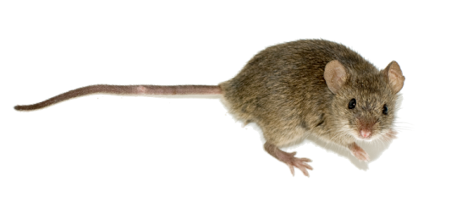
Part II. Current Research on lipoproteins
To date, the only ‘potential’ known mechanism documented was based on studies performed on mice (Mus musculus).
Like humans, mice possess a similar mode of lipid metabolism and respond to exercise in a similar fashion; that is, the greater the exercise’s intensity, the greater the response [8].
Mice also possess identical lipoprotein receptors found in their liver and adipose sites [8].

Slide 20
Part II. Current Research on lipoproteins
In a study performed by Garelnabi et al. (2005), mice exercised for two weeks showed a dramatic increase in scavenger receptor B1 (SR-B1), CD36, and LDLR [8].
SR-B1 and CD36 are multifunctional proteins known for their ability to recognize oxidized LDL and facilitate their removal via direct uptake in the liver. Likewise, LDLR mediates the cellular uptake and degradation of plasma LDL [8].

Slide 21
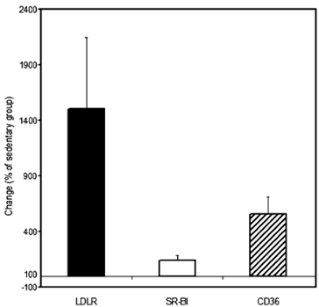
Part II. Current Research on lipoproteins
Animals that were subjected to exercise showed a 14 fold increase in LDL receptor gene expression in the liver [8].
This possibly suggests that LDL receptor mediated clearance of LDL could be important in the anti-atherogenic benefits of exercise [8].
There was a 2 to 3 fold increase in SR-BI expression in the exercising animals and a 4 fold induction of CD36 gene expression, suggesting that reverse cholesterol transport could play an important role in exercise-induced benefits [8].
Figure 4.Exercise-induced data is expressed as mean percentage (%) change in receptor expression of LDLR, SR-B1, or CD36 as compared to the sedentary group. Modified from [8].

Slide 22
1
As one’s muscle contracts during exercise, it induces cytokine
interleukin-6 (IL-6) gene expression locally in contracting skeletal
muscles. Likewise, an exercising limb releases high amounts of IL-6
into the blood. In fact, IL-6 levels increase dramatically (≤100-fold) in
response to exercise [7].
2
Nucleus &
Endoplasmic
Reticulum
3
The IL-6 that is produced passes through the bloodstream and eventually binds to its receptor on hepatocytes.
IL-6 Receptor
Newly formed
LDLR
IL-6
IL-6
Hepatocyte
IL-6 binding induces the LDLR gene by acting on its promoter site; thus, further enhancing the binding of nuclear proteins to their cognate DNA sequence of the LDLR promoter (not shown). In turn, stimulating LDLR transcription [9].
Endothelial
Cell
4
LDL
Degraded LDL
Consequently, the LDLR activity on the surface of liver cells is enhanced, leading to an increased uptake of LDL from the circulation [9].

Slide 23
Conclusion
Although damage to arteries and blood vessels cannot be reversed, exercising regularly will reduce further damage by reducing LDL and increasing HDL cholesterol. The less LDL in the bloodstream, the less there is available to trigger or promote the artery-clogging process known as atherosclerosis.

Slide 24
References
[1] Ades P. A., Coello C. E., & Green N. M. (2003). Effects of exercise and cardiac rehabilitation on cardiovascular outcomes. Clinical Cardiology, 21: 435-448.
[2] Bales W. C., Duscha B. D., Kraus W. E., Houmard J. A., Knetzger K. J., Krishnaji R. K., McCartney J. S., Otvos J. D., Sarah H., Samsa G. P., Slentz C. A., Wharton M. B. (2002). Effects of the Amount and Intensity of Exercise on Plasma Lipoproteins. The New England Journal of Medicine, 347: 1483-1492.
[3] Bateman L. A., Duscha B. D., Kraus W. E., Houmard J. A., Johanna L. J., McCartney J. S., Slentz C. A., & Tanner C. J. (2007). Inactivity, exercise training and detraining, and plasma lipoproteins. STRRIDE: a randomized, controlled study of exercise intensity and amount. Journal of Applied Physiology, 22(6): 432-442.
[4] Bruin T. W., & van Greevenbroek M. M. (1998). Chylomicron synthesis by intestinal cells in vitro and in vivo. Atherosclerosis, 141: 9-16.
[5] Campbell M. K., & Farrell S. O. (2006). Biochemistry (5 ed.). Thompson: Brooks/Coles.
[6] Campos H., & Sacks F. M. (2003). Low-Density Lipoprotein Size and Cardiovascular Disease: A ReappraisalThe Journal of Clinical Endocrinology & Metabolism, 88(10): 4525–4532.
[7] Febbraio M., Fischer C., Keller C., Keller P., Pedersen B. K., Plomgaard P., Steensberg A., Wolsk-Petersen E. (2004). The metabolic role of IL-6 produced during exercise: is IL-6 an exercise factor? Proceedings of the Nutrition Society, 63: 263-267.
[8] Garelnabi M., Penumetchab M., Liud Y, Parthasarathyc S., Santanamc N., Santanamc N., & Weia C. (2005). Exercise might favor reverse cholesterol transport and lipoprotein clearance: Potential mechanism for its anti-atherosclerotic effects. Biochimica et Biophysica Acta, 1723: 124-127.
[9] Gierens H., März W., Nauck M., Neuhaus G., Roth M., Scharnagl H., Schinker R., Schürmann C., & Wieland H. (2000). Interleukin-6 Stimulates LDL Receptor Gene Expression via Activation of Sterol-Responsive and Sp1 Binding Elements. Arteriosclerosis, Thrombosis, & Vascular Biology, 20: 1777-1783.
[10] Moffatt R. J., & Stamford B. A. (2006). Lipid Metabolism and Health, CRC Press.
[11] Schlenker E. D., & Williams S. R. (2003). Essentials of Nutrition and Diet Therapy. Elsevier Health Sciences.

